Slide 1
USCRI
Refugee Medical Assistance Support Services Talk and Go
www.refugees.org

Slide 2


Who is USCRI?
USCRI stands for
U.S. Committee for Refugees and Immigrants.
USCRI is a non-profit organization dedicated to addressing the needs and rights of refugees and immigrants.
USCRI Refugee Health Services supports and develops health and wellness initiatives, including administering the Refugee Medical Assistance (RMA) program.

Slide 3
Overview
Support Services: NEMT & Language Services
RMA Talk and Go Portal

Slide 4
Non-Emergency Medical Transportation & Language Interpretation Services

Slide 5
Support Services
Non-Emergency Medical Transportation
RMA non-emergency medical transportation (NEMT) services can be arranged through USCRI.
RMA NEMT can be scheduled to take you to and from your doctor, the hospital, other medical appointments, and the pharmacy to pick up prescriptions.
This service is free.
Requests should be made 3 business days before the appointment.
You can request this service directly, or your resettlement agency can assist you.
Individuals with more than 5 cancellations will be terminated from transportation services.

Slide 6


Support Services
Non-Emergency Medical Transportation
USCRI arranges transportation through
Uber Health and Amera Solutions
RMA transportation can be used only for rides to appointments with contracted providers for RMA-covered, non-emergency services.
RMA transportation can be used to attend follow-up medical screening appointments. It is not available for the initial medical screening.
RMA transportation services are intended for use only when other transportation options are unavailable.

Slide 7

Support Services
Language Interpretation
If your doctor does not provide an interpreter, USCRI can arrange language interpreting services for your medical appointments.
This service is free.
Request should be made 3 business days before the medical appointment.
You can request this service directly or your resettlement agency can assist you.
Individuals with more than 5 cancellations will be terminated from language access services.

Slide 8
RMA Talk and Go

Slide 9
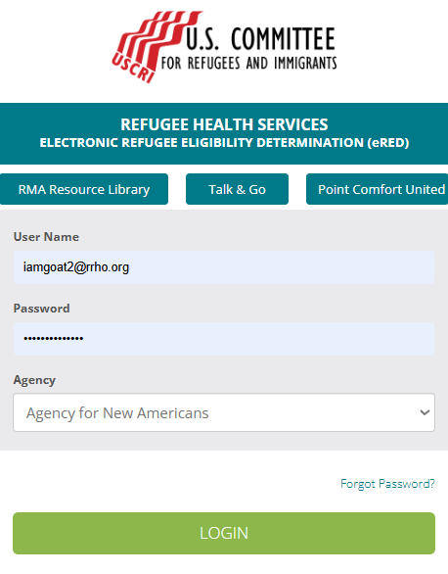
Accessing through eRED Login Page

Slide 10

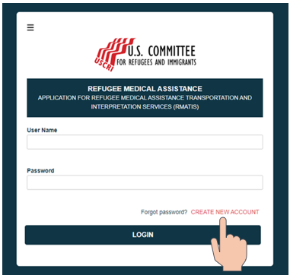
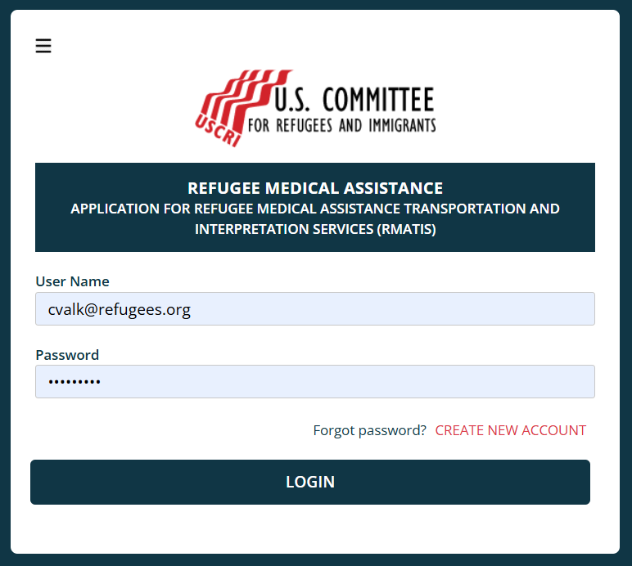
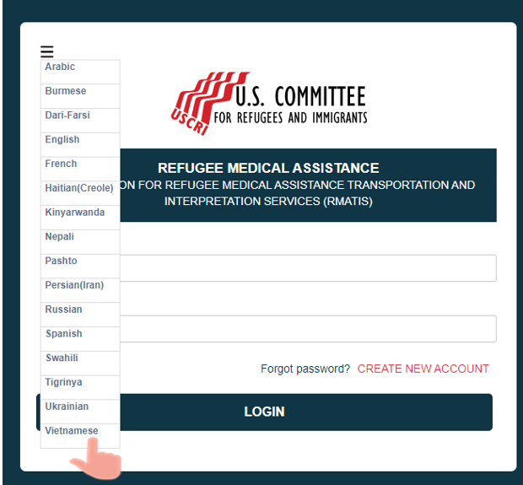
Getting Started: User Profile on Talk and Go
Go to: https://www.rmatalkandgo.org/
Click the three bars to view the Language you want to see the webpage displayed on your screen.
Select the Language you prefer
Click on CREATE NEW ACCOUNT
You will then be directed to a new page to complete your User profile

Slide 11
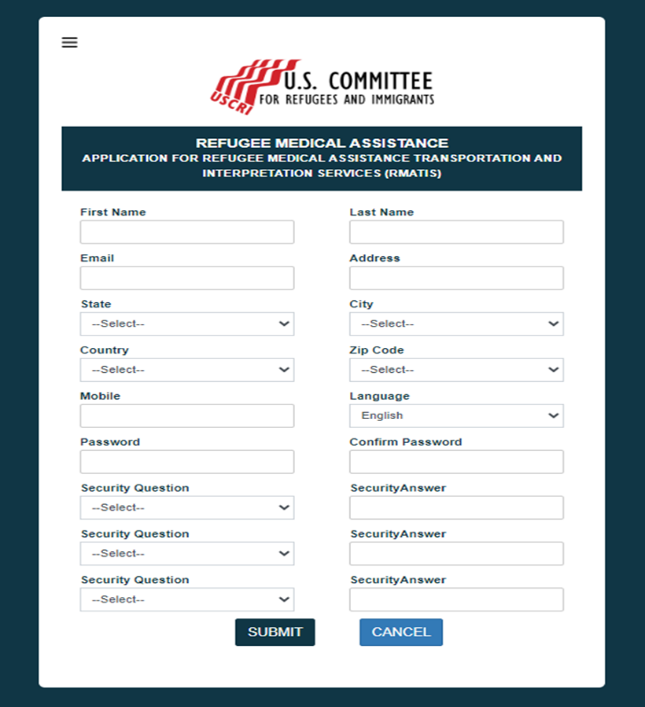
Complete User Profile
Notes:
Note: Password
Must contain at least one upper letter, one lower letter and one special Character (!@#$%&*)

Slide 12
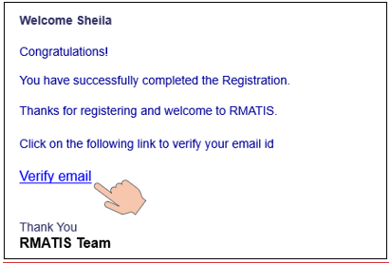

Confirming User Account
Notes:
Upon submission, users will receive an email with a verification link. They must open the email and click "Verify email" to activate their account. Once verified the account will be active and ready to use.

Slide 13
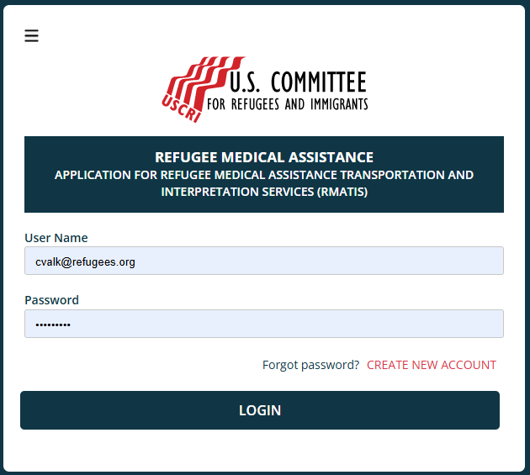
Confirming User Account
Notes:
Enter credentials and click LOGIN
If the user has trouble signing in, click on “Forgot Password?” and follow the instructions sent via email.

Slide 14
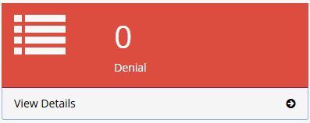
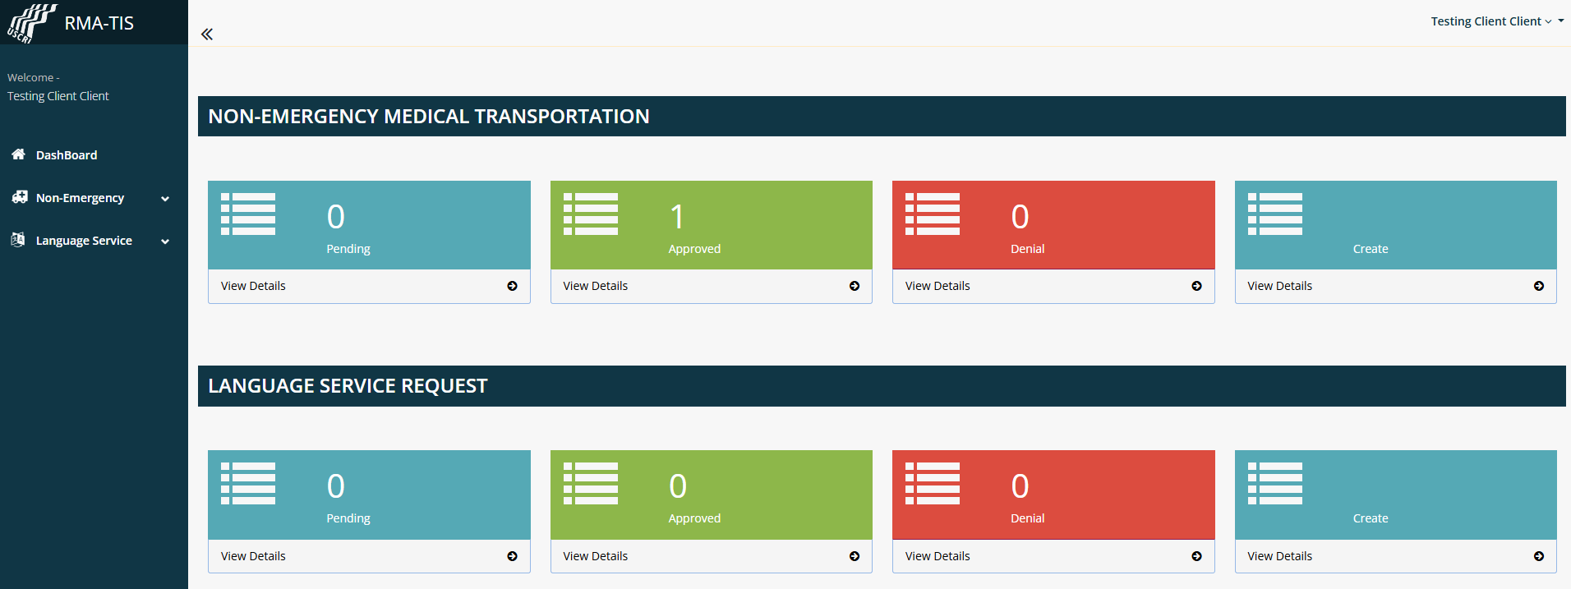
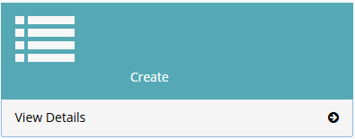
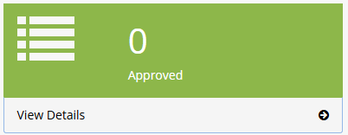
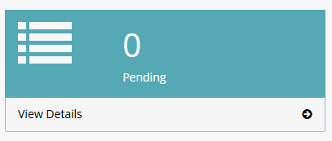
RMA Talk and Go Homepage
Notes:
RMA Talk and Go homepage provides a dashboard where both clients and case workers can track the status of the NEMT and Language Service Request applications.
Clients: Can view the status of their own Non-Emergency Medical Transportation (NEMT) and Language Service requests.
Case Workers: Can view and manage requests submitted on behalf of their assigned clients.
The homepage is separated into four categories: Pending, Approved, Denial and a Create button.

Slide 15
RMA Talk and Go Homepage
Notes:
To start a Transportation request, click “View Details” in the Create box under the NON-EMERGENCY MEDICAL TRANSPORTATION section. The user will then be directed to a new page to begin filling out the request.

Slide 16
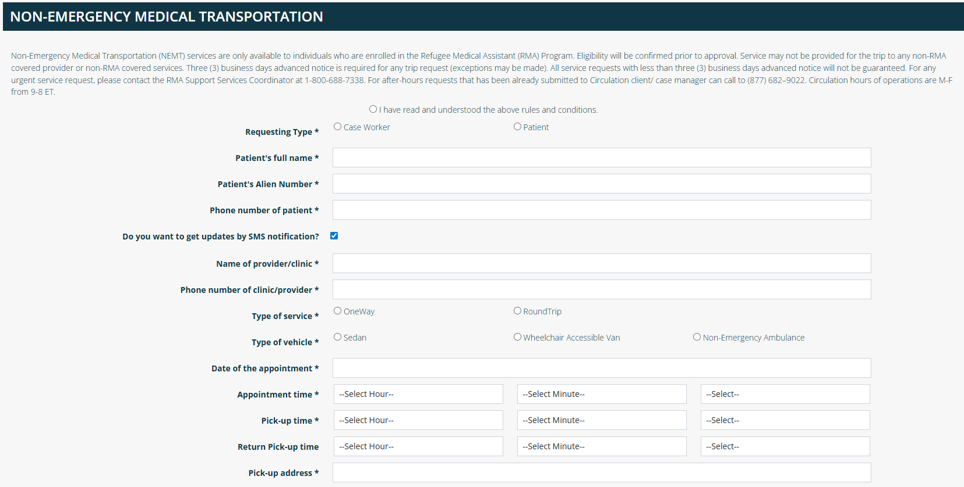
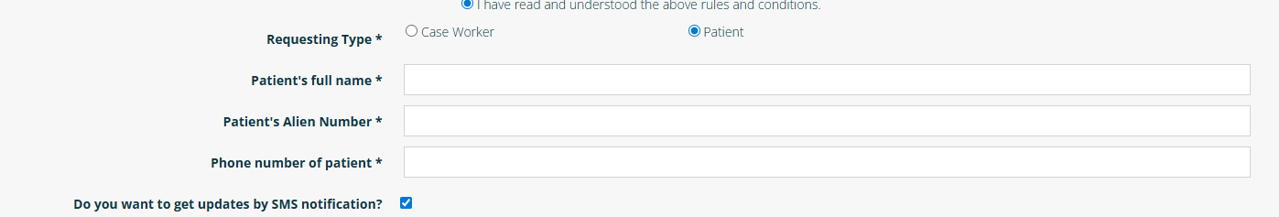
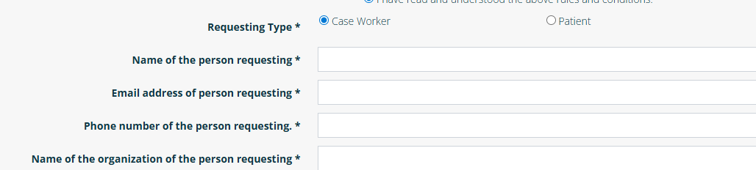
Submitting a NEMT Request: Requesting Type
Notes:
First you will need to read the rules and conditions at the top of the screen and indicate you have read and understood them.
Next you will need to indicate who is requesting
If you click Case Worker, then 4 new boxes will appear below so the case worker can provide their contact details.
If you click Patient, then the form will remain the same.

Slide 17
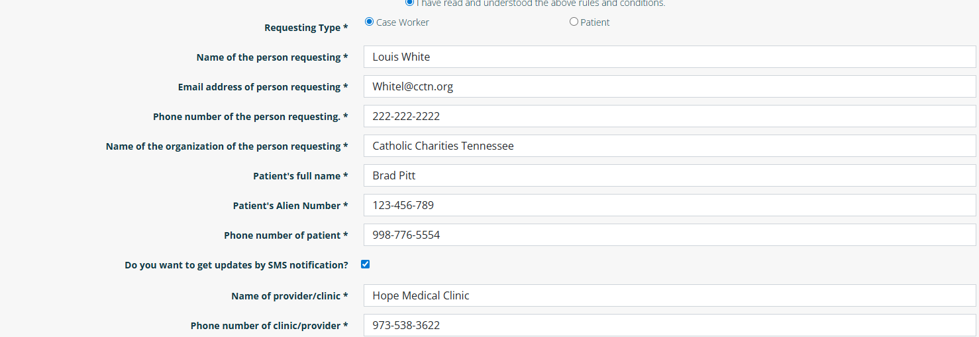
Submitting a NEMT Request Cont.
Notes:
In this example we are filling out the form as a case worker on behalf of our client Brad Pitt. The case worker needs to provide their contact information on their client/patient’s contact information.

Slide 18
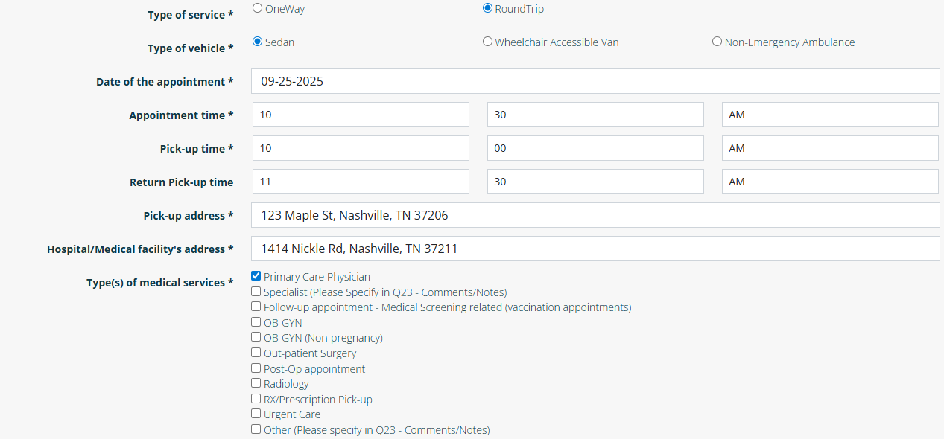
Submitting a NEMT Request Cont.
Notes:
Fill out the form accordingly. Let our Support Services Coordinator know:
If this is a Roundtrip or a One Way trip.
What type of vehicle is needed
Select what type of medical service they are going to
Note: If you want to leave the return pick up time open so that the client can summon a ride at their own convenience using the link and code sent to their phone. Or the client can give us a specific time ahead of time of when they will need to be picked back up from their appointment

Slide 19
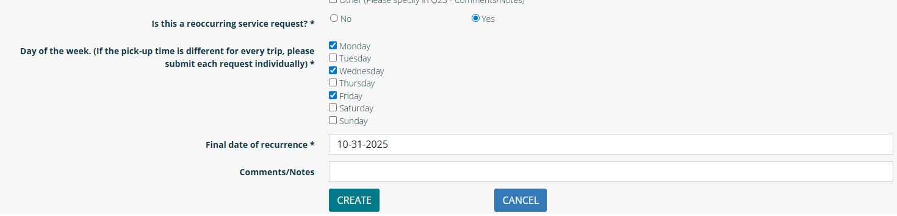
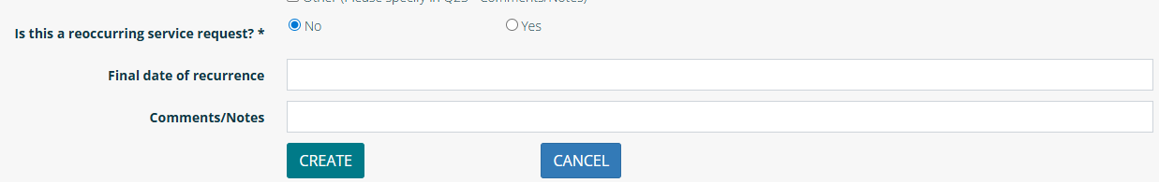
Submitting a NEMT Request Cont.
Notes:
Next let our Support Services Coordinator know if this is a reoccurring request.
Select No or Yes
If No, Then provide any comments if needed and then click Create to submit your request
If Yes, then select the reoccurring day and enter the date of final recurrence
Then click Create to submit your request.

Slide 20
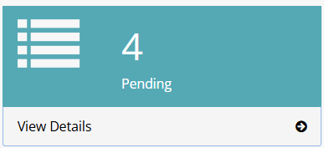
Submitting a NEMT Request Cont.
The next page will confirm that your scheduled service request has been successfully submitted and will appear in the pending folder.

Slide 21
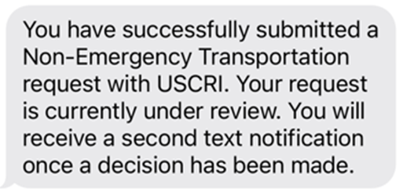
NEMT Request Text Message Notification: Submission
Once submitted, the case worker or client/patient will receive this text message:

Slide 22
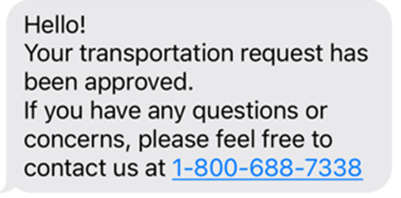
NEMT Request Text Message Notification: Approved
Once the request has been approved, the case worker or client/patient will receive this text message:

Slide 23
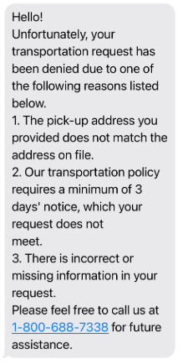
NEMT Request Text Message Notification: Denied
If the request has been denied; the case worker or client/patient will receive this text message listing potential reasons why the request was denied.

Slide 24
RMA Talk and Go Homepage
Notes:
To start a Transportation request, click “View Details” in the Create box under the NON-EMERGENCY MEDICAL TRANSPORTATION section. The user will then be directed to a new page to begin filling out the request.

Slide 25
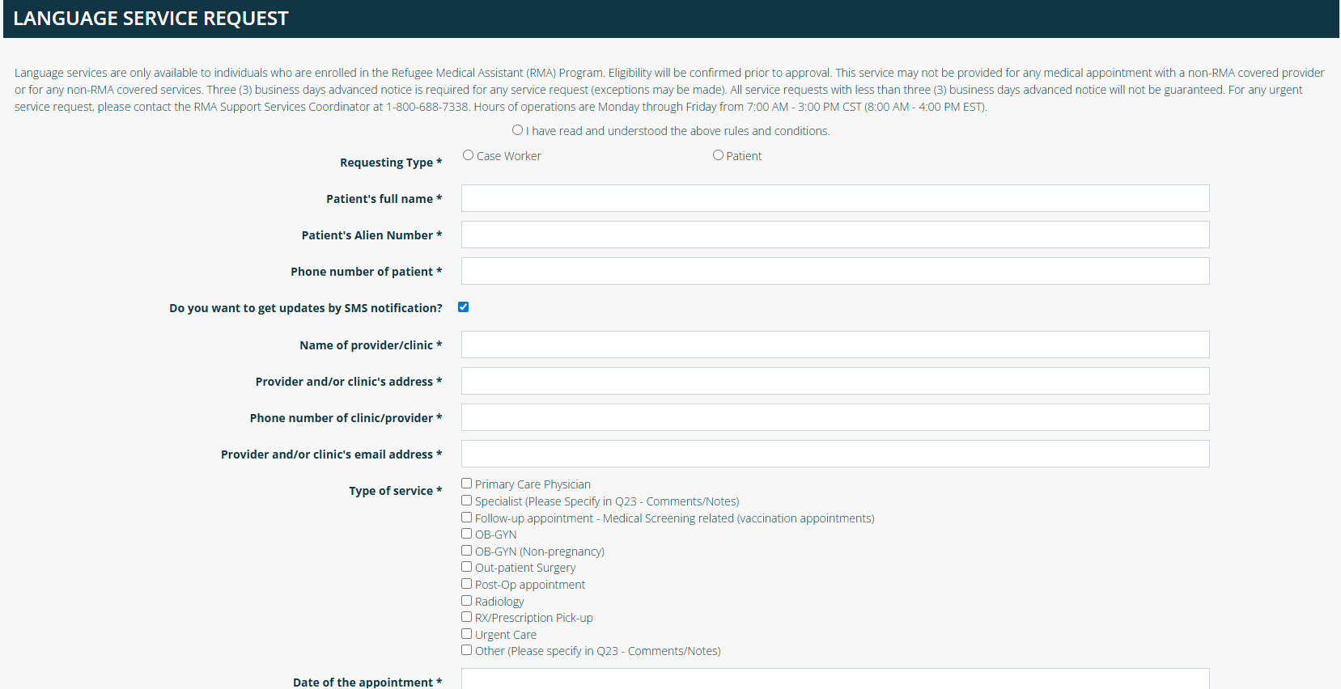
Submitting a Language Request: Requesting Type
Notes:
First you will need to read the rules and conditions at the top of the screen and indicate you have read and understood them.
Next you will need to indicate who is requesting
If you click Case Worker, then 4 new boxes will appear below so the case worker can provide their contact details.
If you click Patient, then the form will remain the same.

Slide 26
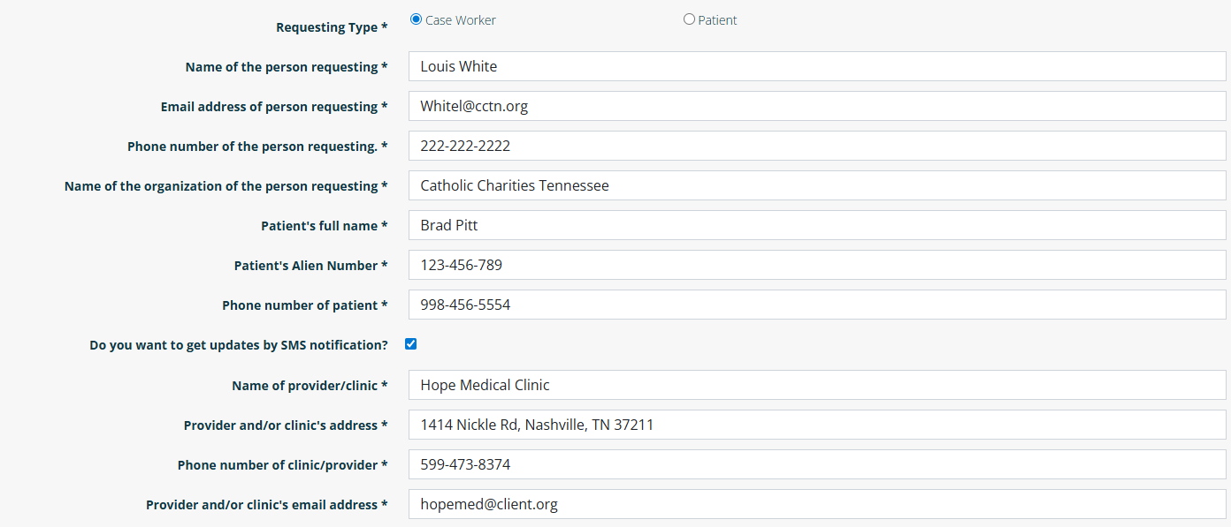
Submitting a Language Request Cont.
Notes:
In this example we are filling out the form as a case worker on behalf of our client Brad Pitt. The case worker needs to provide their contact information on their client/patient’s contact information.

Slide 27
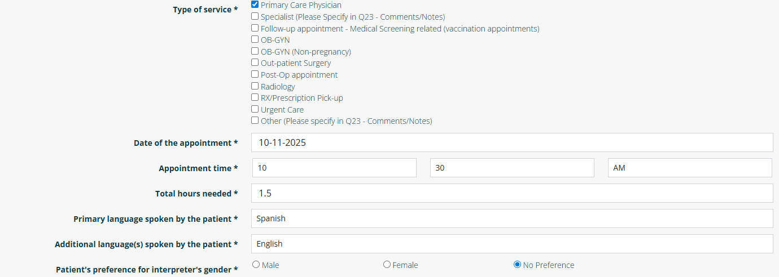
Submitting a Language Request Cont.
Notes:
Fill out the form accordingly. Let our Support Services Coordinator know:
If this is a Roundtrip or a One Way trip.
What type of vehicle is needed
Select what type of medical service they are going to
Note: If you want to leave the return pick up time open so that the client can summon a ride at their own convenience using the link and code sent to their phone. Or the client can give us a specific time ahead of time of when they will need to be picked back up from their appointment

Slide 28
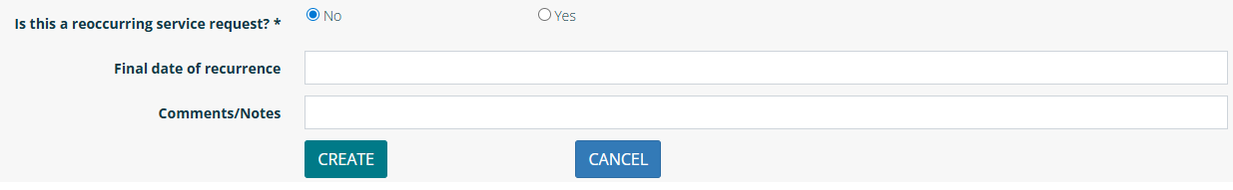
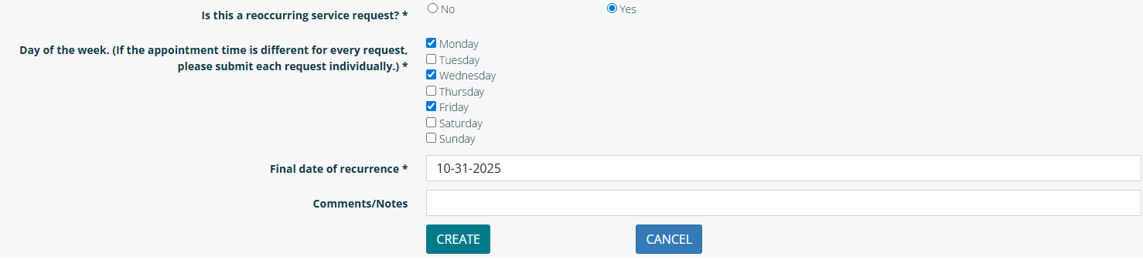
Submitting a Language Request Cont.
Notes:
Next let our Support Services Coordinator know if this is a reoccurring request.
Select No or Yes
If No, Then provide any comments if needed and then click Create to submit your request
If Yes, then select the reoccurring day and enter the date of final recurrence
Then click Create to submit your request.

Slide 29
Submitting a Language Request Cont.
The next page will confirm that your scheduled service request has been successfully submitted and will appear in the pending folder.

Slide 30
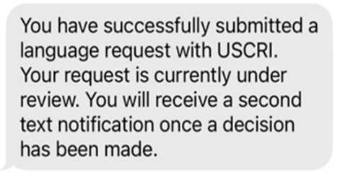
Language Service Request Text Message Notification: Submission
Once submitted, the case worker or client/patient will receive this text message:

Slide 31
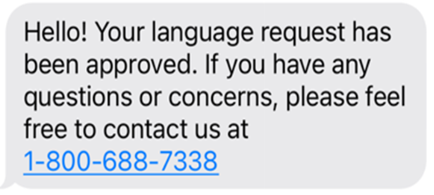
Language Service Request Text Message Notification: Approved
Once the request has been approved, the case worker or client/patient will receive this text message:

Slide 32
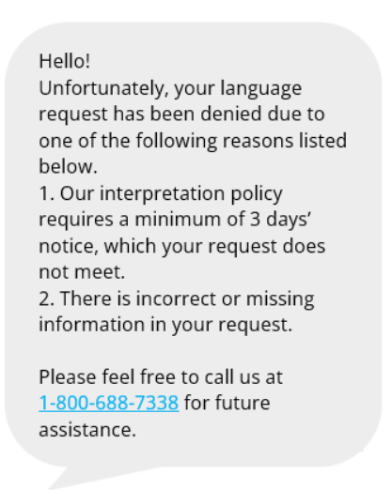
Language Service Request Text Message Notification: Denied
If the request has been denied; the case worker or client/patient will receive this text message listing potential reasons why the request was denied.

Slide 33


Additional Options to Contact Support Services
USCRI Support Service office hours are Monday-Friday, 8AM- 4PM EST (7AM-3PM CST)
1-800-688-7338
*If you do not speak English, tell us what language you would like to speak in and we will connect an interpreter to the call.
Transportation: rmatransportation@refugees.org
Interpretation: rmalanguageservices@refugees.org
Phone
Email

Slide 34


Tha nk Yo u
USCRI Support Services
1-800-688-7338
rmatransportation@refugees.org
rmalanguageservices@refugees.org

